Slide 1
Module 10
A Multi-Objective Transshipment Challenge

Slide 2
Scenario
The Candy Kingdom is preparing for its annual Gumball Gala, and logistics are getting sticky! Fortunately, your candy shop has been contracted to service the kingdom! A giant stockpile of gumballs has been secured at the central hub and your job is to route them to a variety of candy dispensary locations scattered across the kingdom
But this isn't just any shipment: you are a Candy Supply Optimization Specialist, and your task is to develop a Multiple Objective Linear Program (MOLP) to deliver all the gumballs efficiently, ethically, and eco-consciously.

Slide 3
Objective
Formulate a MOLP model that determines how much candy should be transported along each route, ALL DEMAND MUST BE FULLY MET while balancing the following competing goals:
Minimize total transportation cost
Minimize total distance traveled
Maximize eco-friendliness (favor green transport like wind-powered ships or electric trucks)
Minimize congestion levels (avoid overused routes when possible)
*For this module, assume each objective is equally weighted in your base model. Later scenarios will explore how different priorities affect outcomes.

Slide 4
Your Data
Module10_Locations.csv
location_id
location_name
latitude
longitude
supply
demand
Module10_Connections.csv
from
to
cost_per_unit_shipped
transportation_method
congestion_level

Slide 5
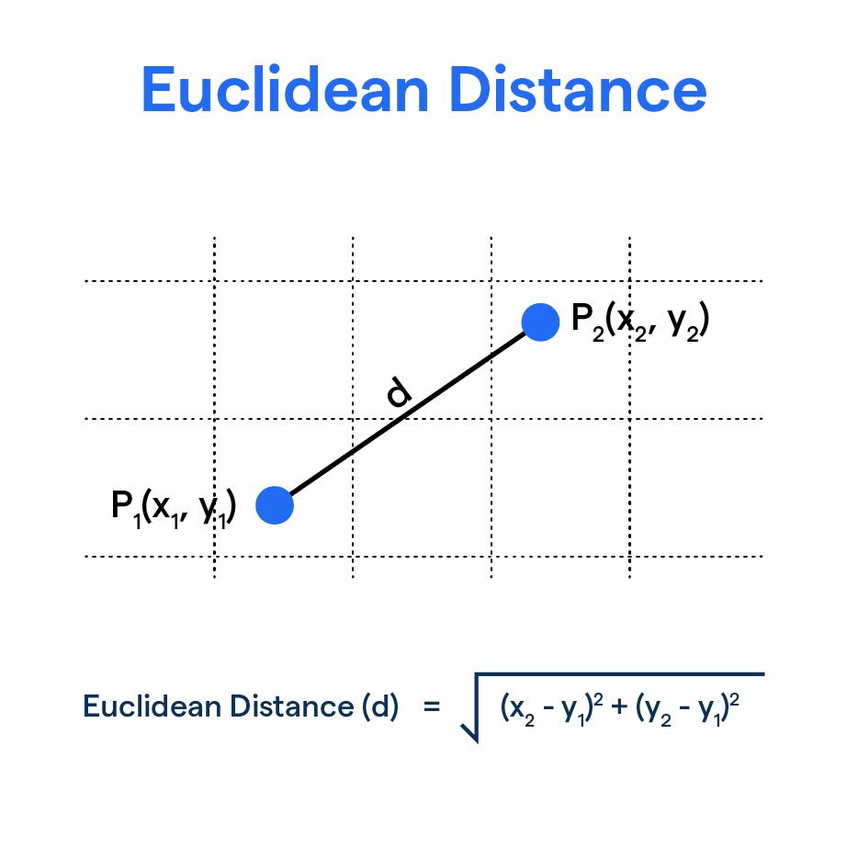
Needed Transformations - Distance
For each arc, calculate the Euclidean distance using the longitude and latitude of the ”from” node and the “to” node

Slide 6
Needed Transformations – Eco-Friendly
Convert the transportation method into a binary variable
Eco-Friendly Alternatives
Electric/Hybrid Trucks
Electrified Rail
Wind-powered Ships
Slow Steaming Cargo Ships
Less Eco-Friendly Methods
Diesel Trucks
Diesel Rail
Air Freight
Cargo Ships (Heavy Fuel Oil)

Slide 7
Needed Transformations - Congestion
Convert the congestion level provided to a binary variable.
Assume a congestion level >= 70 is high congestion (1) otherwise low congestion (0)

Slide 8
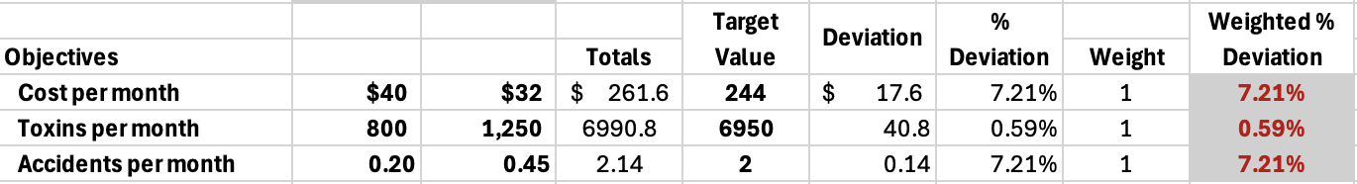
Hints/Advice
Review the Transshipment model formulation we previously covered in class
Get your data together with all transformations prior to solving any objective
Start with an objective we’ve done prior, the cost_per_unit_shipped field
Your model will likely look like the original Transshipment problem with a table like the class example to be able to apply weights & deviations for MINIMAX

